Slide 1

Sprocket Central Pty Ltd
Data analytics approach
Abhishek Zine

Slide 2
Agenda
Introduction
Profit By Brand
Profit Analysis
Dashboard

Slide 3
Introduction
Sales Analysis
Average Profit By Brand
Average Profit By State
Month wise Average Profit
Profit By Product Id

Slide 4
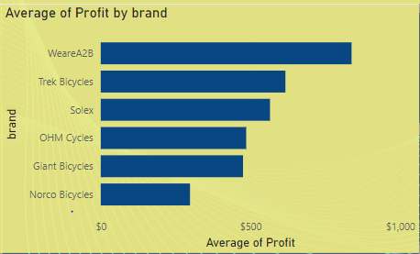
Data Analysis
Profit By Brand
As we can see, There Are 6 brands that we provides to customer.
Brands Name Are as Follows,
WeareA2B, Trek Bicycles, Solex,
OHM Cycles, Giant Bicycles, Norco Bicycles.
After Analysing the data we found that the Most Selling Brand Is WeareA2B

Slide 5
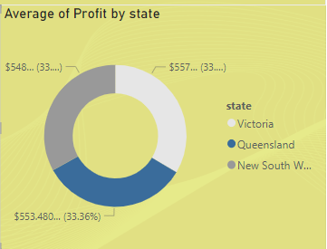
Profit Analysis
Profit By State
There are 3 state in which our services are provided
Queensland, New South Wales, Victoria Are the state in our service.
Most Contributed state for profit after analyzing the data are Victoria.
Victoria contributes 33.58% profit in our sales.

Slide 6
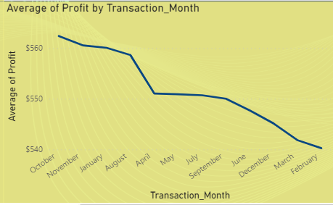
Interpretation
Month Wise Sales Analysis
October Is the most contributed month in profit analysis.
Month wise profit give the insights of strategic planning for the services or product to be sell.

Slide 7
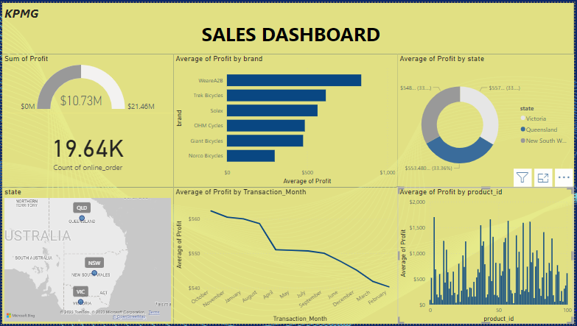
Sales Dashboard

Slide 8
Appendix

Slide 9
Appendix
All supporting items in that attachment.

